Slide 1

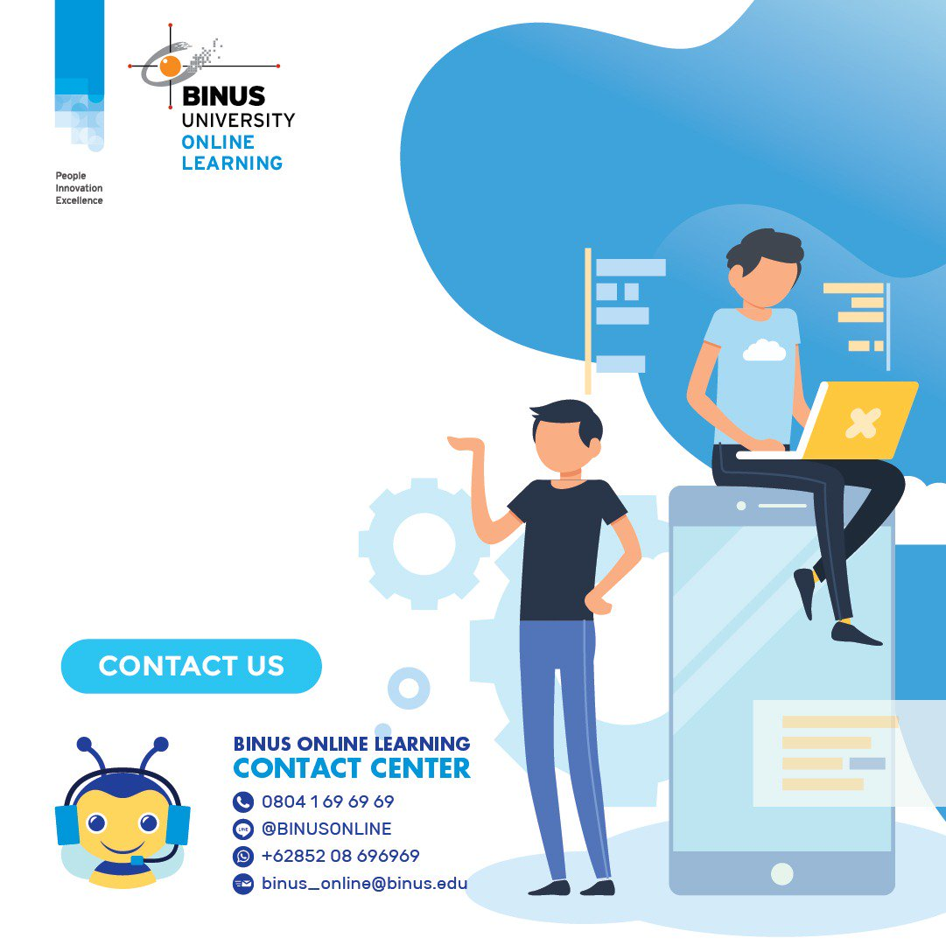




Success in:
BINUS
Online learning

Slide 2



01
Identify the common attributes of a successful online learner
Our objectives
02
Recognize your intrinsic motivation and how to address it properly
03
Set your own self-directed learning plan

Slide 3
Contents
Common characteristics of a successful online learner
How to set your own self-directed learning plan
What does experts say about how an ideal online learner should act
Plan your own course of action in achieving your goal and cultivate your intrinsic motivation
Part 1
Part 2
Part 3
Part 4
An introduction to Self-determination Theory
Helpful resources and how to use it
Get to know with the theory behind our motivation – the drivers of all conducts
Some universal resources to help students conducting their study and how to use it properly
01

Slide 4
Common characteristics of a successful online learner
How to set your own self-directed learning plan
What does experts say about how an ideal online learner should act
Plan your own course of action in achieving your goal and cultivate your intrinsic motivation
Part 1
Part 2
Part 3
Part 4
An introduction to Self-determination Theory
Helpful resources and how to use it
Get to know with the theory behind our motivation – the drivers of all conducts
Some universal resources to help students conducting their study and how to use it properly
01
Common attributes of a successful online learner
Ask yourself,
Notes:
https://www.northeastern.edu/graduate/blog/tips-for-taking-online-classes/

Slide 5

Time management
The flexibility to create your own schedule is often one of the biggest appeals of taking online classes. But that freedom can also be a disaster if you do not have solid time management skills. Without them, you might easily to find yourself cramming before classes or handing in low quality assignments.
Though how you manage your time will depend on your schedule, learning style, and personality, here are some universally valuable tips to help you practice and improve your time management skills
01

Slide 6
Time management
Make note of major assignments
The flexibility to create your own schedule is often one of the biggest appeals of taking online classes. But that freedom can also be a disaster if you do not have solid time management skills. Without them, you might easily to find yourself cramming before classes or handing in low quality assignments.
Though how you manage your time will depend on your schedule, learning style, and personality, here are some universally valuable tips to help you practice and improve your time management skills
Create a weekly schedule that you follow
Try time-blocking
Check in periodically throughout the term

Slide 7




Time management
Make note of major assignments
The flexibility to create your own schedule is often one of the biggest appeals of taking online classes. But that freedom can also be a disaster if you do not have solid time management skills. Without them, you might easily to find yourself cramming before classes or handing in low quality assignments.
Though how you manage your time will depend on your schedule, learning style, and personality, here are some universally valuable tips to help you practice and improve your time management skills
Create a weekly schedule that you follow
Try time-blocking
Check in periodically throughout the term
Notes:
Look at the syllabus at the start of the semester and make note of major assignments. Mark them on a calendar you check regularly so you know what workload is coming in the weeks ahead. Don’t forget to include any personal plans that may interfere with your regular study schedule, such as weddings or vacations, so you can give yourself enough extra time to complete assignments.
Create a weekly schedule that you follow, designating certain hours each week to reading, watching lectures, completing assignments, studying, and participating in forums. Commit to making your online coursework part of your weekly routine and set reminders for yourself to complete these tasks.
When working on your assignments, try time-blocking, allotting yourself a certain amount of time for each task before moving on to the next one and setting a timer to keep you accountable.
Check in periodically throughout the term, and look at how you’re spending your time. Ask yourself: How much time am I dedicating to course reading and assignments? Am I regularly underestimating the time it’s taking me to get things done, forcing me to cram the nights before the exams? A little self-reflection and adjustment can go a long way.

Slide 8

Create regular study space
Set up a dedicated learning environment for studying. By completing your work there repeatedly, you’ll begin to establish a routine. Experiment to discover which type of setting boosts your productivity. Wherever you choose, make sure there’s high-speed internet access so you’re not trying to take an online course over a lagging connection.
Setting up a regular workspace or office will also help you to stay organized. Knowing exactly where important dates, files, forms, syllabi, books, and assignments live will help keep you on track towards hitting your goals. When setting up your study space

Slide 9
Create regular study space
Set up a dedicated learning environment for studying. By completing your work there repeatedly, you’ll begin to establish a routine. Experiment to discover which type of setting boosts your productivity. Wherever you choose, make sure there’s high-speed internet access so you’re not trying to take an online course over a lagging connection.
Setting up a regular workspace or office will also help you to stay organized. Knowing exactly where important dates, files, forms, syllabi, books, and assignments live will help keep you on track towards hitting your goals. When setting up your study space

Slide 10
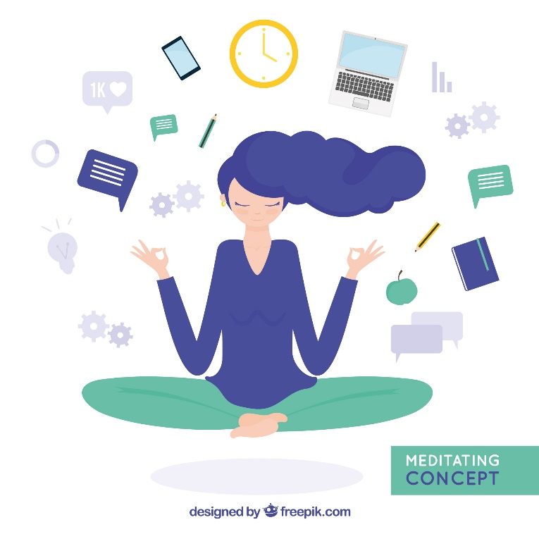
Figure out how you learn best
Once you’ve established where you’ll learn, think about when and how you accomplish your best work. If you’re a morning person, make time to study first thing when you wake up. More of a night owl? Set aside an hour or two after dinner to cozy up to your computer. If your family require your morning and evening attention, try to carve out a study session mid-day. Brew your usual cup of coffee, put on your go-to playlist, and do whatever you need to get into the zone.
Not everyone learns the same way, so think about what types of information help you best grasp new concepts and employ relevant study strategies. If you’re a visual learner, for example, print out transcripts of the video lectures to review. Learn best by listening? Make sure to build time into your schedule to play and replay all audio- and video-based course content

Slide 11
Figure out how you learn best
Once you’ve established where you’ll learn, think about when and how you accomplish your best work. If you’re a morning person, make time to study first thing when you wake up. More of a night owl? Set aside an hour or two after dinner to cozy up to your computer. If your family require your morning and evening attention, try to carve out a study session mid-day. Brew your usual cup of coffee, put on your go-to playlist, and do whatever you need to get into the zone.
Not everyone learns the same way, so think about what types of information help you best grasp new concepts and employ relevant study strategies. If you’re a visual learner, for example, print out transcripts of the video lectures to review. Learn best by listening? Make sure to build time into your schedule to play and replay all audio- and video-based course content

Slide 12

Eliminate distractions
Regardless of where you choose to work, consider turning your cell phone off to avoid losing focus every time a text message or notification pops up. And if you’re still having trouble resisting the temptation to check your video games or surf the web, try downloading a website blocker. Using applications like Cold Turkey and Freedom can help eliminate distractions by blocking the apps or websites that tend to compete for your attention
From Netflix to social media to video games, you’ll be faced with many distractions that can easily derail your studies. The best online students know how to lessen these distractions and set aside time to focus. Ultimately, you will need to find a strategy that works best for you. Some might find that they can tune out a noisy home by listening to music. Others might choose to work from a local coffee shop or library to eliminate their urge to multitask at home.

Slide 13
Eliminate distractions
Regardless of where you choose to work, consider turning your cell phone off to avoid losing focus every time a text message or notification pops up. And if you’re still having trouble resisting the temptation to check your video games or surf the web, try downloading a website blocker. Using applications like Cold Turkey and Freedom can help eliminate distractions by blocking the apps or websites that tend to compete for your attention
From Netflix to social media to video games, you’ll be faced with many distractions that can easily derail your studies. The best online students know how to lessen these distractions and set aside time to focus. Ultimately, you will need to find a strategy that works best for you. Some might find that they can tune out a noisy home by listening to music. Others might choose to work from a local coffee shop or library to eliminate their urge to multitask at home.

Slide 14

Actively participate
Participate in the course’s online forum to help you better understand course materials and engage with fellow classmates. This might involve commenting on a classmate’s paper on a discussion board or posting a question about a project you’re working on. Read what other students and your lecturer are saying, and if you have a question, ask for clarification.
Make sure you are checking in as often as you can. The flexibility of online learning means that you could squeeze in a discussion response around your schedule. Set a goal to check in on the class discussion threads every day. And if you do feel yourself falling behind, speak up. Don’t wait until an assignment is almost due to ask questions or report issues. Email your lecturer and be proactive in asking for help.

Slide 15
Actively participate
Participate in the course’s online forum to help you better understand course materials and engage with fellow classmates. This might involve commenting on a classmate’s paper on a discussion board or posting a question about a project you’re working on. Read what other students and your lecturer are saying, and if you have a question, ask for clarification.
Make sure you are checking in as often as you can. The flexibility of online learning means that you could squeeze in a discussion response around your schedule. Set a goal to check in on the class discussion threads every day. And if you do feel yourself falling behind, speak up. Don’t wait until an assignment is almost due to ask questions or report issues. Email your lecturer and be proactive in asking for help.

Slide 16

Leverage your network
Build relationships with other students by introducing yourself and engaging in online discussion boards. Your peers can be a valuable resource when preparing for exams or asking for feedback on assignments. Don’t be afraid to turn to them to create a virtual study group. Chances are good that they will appreciate it just as much as you will.
Online classes may sometimes make you feel like you are learning on your own, but this couldn’t be further from the truth. Most online courses are built around the concept of collaboration, with lecturers and instructors actively encouraging that students work together to complete assignments and discuss lessons

Slide 17
Leverage your network
Build relationships with other students by introducing yourself and engaging in online discussion boards. Your peers can be a valuable resource when preparing for exams or asking for feedback on assignments. Don’t be afraid to turn to them to create a virtual study group. Chances are good that they will appreciate it just as much as you will.
Online classes may sometimes make you feel like you are learning on your own, but this couldn’t be further from the truth. Most online courses are built around the concept of collaboration, with lecturers and instructors actively encouraging that students work together to complete assignments and discuss lessons

Slide 18

Hold yourself accountable
Set goals at the beginning of the semester and check-in with yourself weekly. In a traditional classroom setting, you’ll often receive verbal or visual reminders of an assignment’s upcoming due date. But without a lecturer actively reminding you, it’s up to you to make sure you’ve allotted enough time to complete the work so you’re not starting an assignment the day before it’s due.
If you’re having trouble holding yourself responsible, pair up with a fellow classmate, or asks the help of a spouse or friend to check in as an accountability partner. By being organized, proactive, and self-aware, you can get the most from your online class even when life outside of school becomes chaotic.

Slide 19
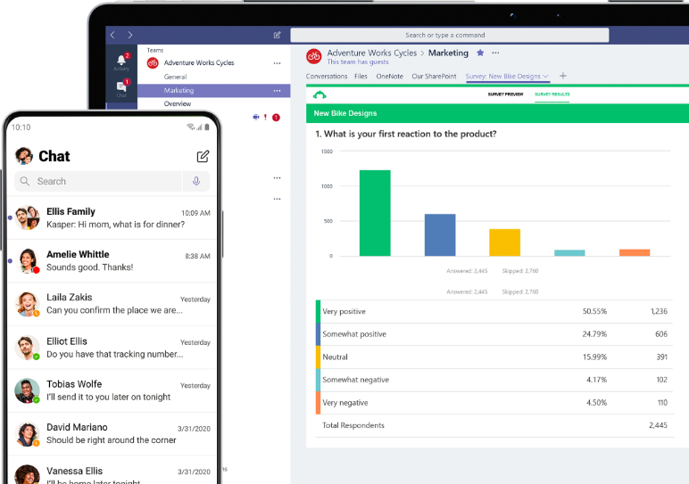

Hold yourself accountable
Set goals at the beginning of the semester and check-in with yourself weekly. In a traditional classroom setting, you’ll often receive verbal or visual reminders of an assignment’s upcoming due date. But without a lecturer actively reminding you, it’s up to you to make sure you’ve allotted enough time to complete the work so you’re not starting an assignment the day before it’s due.
If you’re having trouble holding yourself responsible, pair up with a fellow classmate, or asks the help of a spouse or friend to check in as an accountability partner. By being organized, proactive, and self-aware, you can get the most from your online class even when life outside of school becomes chaotic.
One of the best tools you can utilize to help you more accountable, organized, and allow collaboration as well, is . By using your binus.ac.id email account, you can start using Microsoft Teams with your classmates or lecturers.

Slide 20
Hold yourself accountable
Microsoft Teams empowers teamwork and content collaboration through a variety of features.
Set goals at the beginning of the semester and check-in with yourself weekly. In a traditional classroom setting, you’ll often receive verbal or visual reminders of an assignment’s upcoming due date. But without a lecturer actively reminding you, it’s up to you to make sure you’ve allotted enough time to complete the work so you’re not starting an assignment the day before it’s due.
If you’re having trouble holding yourself responsible, pair up with a fellow classmate, or asks the help of a spouse or friend to check in as an accountability partner. By being organized, proactive, and self-aware, you can get the most from your online class even when life outside of school becomes chaotic.
One of the best tools you can utilize to help you more accountable, organized, and allow collaboration as well, is . By using your binus.ac.id email account, you can start using Microsoft Teams with your classmates or lecturers.
Communication driven by instant messaging and audio/video chat.
Live meetings and on-demand recordings.
Integrations with Office 365 apps such as Planner as well as third-party services.
Mobile app for on-the-go teamwork.

Slide 21
Hold yourself accountable
Microsoft Teams empowers teamwork and content collaboration through a variety of features.
One of the best tools you can utilize to help you more accountable, organized, and allow collaboration as well, is . By using your binus.ac.id email account, you can start using Microsoft Teams with your classmates or lecturers.
Communication driven by instant messaging and audio/video chat.
Live meetings and on-demand recordings.
Integrations with Office 365 apps such as Planner as well as third-party services.
Mobile app for on-the-go teamwork.

Slide 22






Time management
Regular study space
Figure out how you learn best
Eliminate distraction
Common attributes of a successful online learner
Actively participate
Leverage network
Hold yourself accountable

Slide 23
02
An introduction to Self-determination Theory

Slide 24


Self-determination theory
“
It highlights the importance of humans evolved inner resources for personality development and behavioral self-regulation.
Ryan, R. M., & Deci, E. L. (2000). Self-determination theory and the facilitation of intrinsic motivation, social development, and well-being. American Psychologist, 55(1), 68-78.
Notes:
People’s inherent growth tendencies and innate psychological needs that are the basis for their self-motivation and personality integration.
appear to be essential for facilitating optimal functioning of the natural propensities for growth and integration, as well as for constructive social development and personal well-being.

Slide 25
Self-determination theory
“
The fullest representations of humanity – curious, vital, and self-motivated. At their best, they are agentic and inspired, striving to learn; extend themselves; master new skills; and apply their talents responsibly.
Ryan, R. M., & Deci, E. L. (2000). Self-determination theory and the facilitation of intrinsic motivation, social development, and well-being. American Psychologist, 55(1), 68-78.
Notes:
Yet, it is also clear that the human spirit can be diminished or crushed and that individuals sometimes reject growth and responsibility. Regardless of social strata or cultural origin, examples of both children and adults who are apathetic, alienated, and irresponsible are abundant. Such non-optimal human functioning can be observed among the millions who, for hours a day, sit passively before their televisions, stare blankly from the back of their classrooms, or wait listlessly for the weekend as they go about their jobs.

Slide 26



Competence – a sense of being able to do something
Self-determination theory
Competence
Innate psychological needs
Relatedness – a sense of being associated or connected with others
Autonomy – a sense of being in control
Relatedness
Autonomy
Notes:
Underpinning SDT is that people require the satisfaction of three basic psychological needs

Slide 27



Self-determination theory
Relatedness
The need for competence means the desire to control and master our environment and outcome. We want to know how things will turn out and what the result are of our actions.
To be autonomous does not mean to be independent. It means having a sense of free will when doing something or acting out of our own interests and values.
Competence
Our actions and daily activities relates other people and through this, we seek the feeling of belongingness.
Autonomy
https://bonlinelearning.com/online-learning-and-self-determination-theory/

Slide 28
Self-determination theory
Competence
The need for competence means the desire to control and master our environment and outcome. We want to know how things will turn out and what the result are of our actions.
To be autonomous does not mean to be independent. It means having a sense of free will when doing something or acting out of our own interests and values.
Autonomy
Our actions and daily activities relates other people and through this, we seek the feeling of belongingness.
Relatedness
https://bonlinelearning.com/online-learning-and-self-determination-theory/

Slide 29
Self-determination theory
Autonomy
The need for competence means the desire to control and master our environment and outcome. We want to know how things will turn out and what the result are of our actions.
To be autonomous does not mean to be independent. It means having a sense of free will when doing something or acting out of our own interests and values.
Relatedness
Our actions and daily activities relates other people and through this, we seek the feeling of belongingness.
Competence
https://bonlinelearning.com/online-learning-and-self-determination-theory/

Slide 30


Intrinsic & Extrinsic motivation
“
Motivation concerns energy, direction, persistence and equifinality – all aspects of activation and intention.
Notes:
Comparison between people whose motivation is authentic and those who are merely externally controlled have more interest, excitement, and confidence.
Have enhanced performance, persistence, and creativity
Heightened vitality, self-esteem, and general well-being

Slide 31
Mediators of intrinsic motivation
Vallerand and Reid (1984) found that Intrinsic motivation were mediated by perceived competence. Thus, optimal challenges and positive performance feedback enhanced it, whereas negative performance feedback diminished it (Deci, 1975)
Feelings of competence will not enhance intrinsic motivation unless accompanied by a sense of autonomy or in attributional terms, perceived locus of causality (deCharms, 1968). Choice, acknowledgment of feelings, and opportunities for self-direction were found to enhance intrinsic motivation.
Notes:
threats, deadlines, directives, pressured evaluations, and imposed goals diminish intrinsic motivation because, like tangible rewards, they conduce toward an external perceived locus of causality.

Slide 32
Mediators of intrinsic motivation
perceived competence
perceived locus of causality
Intrinsic motivation also more likely to flourish in contexts characterized by a sense of security and relatedness. Hence, a secure relational base does seem to be important for the expression of intrinsic motivation (Ryan & Grolnick, 1986).
Notes:
In infancy, intrinsic motivation is readily observable as exploratory behavior and, as suggested by attachment theorists (e.g., Bowlby, 1979), it is more evident when the infant is securely attached to a parent.
Anderson, Manoogian, and Reznick (1976) found that when children worked on an interesting task in the presence of an adult stranger who ignored them and failed to respond to their initiations, a very low level of intrinsic motivation resulted, and Ryan and Grolnick (1986) observed lower intrinsic motivation in students who experienced their teachers as cold and uncaring.
Of course, many intrinsically motivated behaviors are happily performed in isolation, suggesting that proximal relational supports may not be necessary for intrinsic motivation

Slide 33
Mediators of intrinsic motivation
perceived competence
perceived locus of causality
sense of security

Slide 34
Controlled motivation
Autonomous motivation
Lower Motivational Quality
Higher Motivational Quality
Extrinsic Motivation
Intrinsic Motivation
Amotivation
External Motivation
Identification
Introjection
Introjection
Lack of perceived competence
Lack of value
External rewards or punishments
Compliance
Reactance
Ego involvement
Focus on approval from self and others
Personal importance
Conscious valuing of activity
Self-endorsement of goals
Congruence
Synthesis and consistency of identifications
Interest
Enjoyment
Inherent satisfaction
External
Somewhat external
Somewhat internal
Internal
Internal
Impersonal
Adapted from Ryan & Deci (2000); @ 2017 Center for Self-Determination Theory
Notes:
SDT proposes that extrinsic motivation can vary in the degree to which it’s either controlling of behavior or allows autonomy. These types of extrinsic motivation sit on what is called Self-determination Continuum
External – performing a task to receive a reward or avoid punishment
Introjection – performing a task to avoid feeling guilty or to please someone else
Identification – the person is starting to identify with the task, improve job performance
Integration – close to intrinsic, but there’s still a separable outcome, preparing for a future job role

Slide 35
03
How to set your own self-directed learning plan
Notes:
Social environments can facilitate or forestall intrinsic motivation by supporting versus thwarting people's innate psychological needs.
first, that social-contextual events (e.g., feedback, communications, rewards) that conduce toward feelings of competence during action can enhance intrinsic motivation for that action.

Slide 36
Mediators of intrinsic motivation
perceived competence
perceived locus of causality
sense of security

Slide 37




Steps in fostering your intrinsic motivation
1
2
3
4
Start with why you really want to learn a new skill
Set clear goals about what you’re planning to learn
Find a learning accountability partner or start an online study group
Apply what you learn by building your own digital portfolio
Notes:
Competence, Autonomy, Relatedness (?)
Autonomy
Competence, Relatedness
Competence, Autonomy, Relatedness
It alls depends on how you use it

Slide 38
1
2
3
4
Start with why you really want to learn a new skill
Set clear goals about what you’re planning to learn
Find a learning accountability partner or start an online study group
Apply what you learn by building your own digital portfolio
“
You have to be intrinsically motivated, which means you are self-motivated by your own internal sense of autonomy, mastery, and purpose. When you define your purpose for learning and how achieving your goal matters will make you feel emotionally, it becomes much easier to stay motivated.

Slide 39
1
2
3
4
Start with why you really want to learn a new skill
Set clear goals about what you’re planning to learn
Find a learning accountability partner or start an online study group
Apply what you learn by building your own digital portfolio
Who benefits from this?
Who is most directly affected?
What are my strengths and weaknesses?
What can I do to make a positive change?
Where would we see this in the real world?
Where are the area for improvement?
When is the best time to take action?
When will we know we have succeeded?
Why is this a problem?
Why are people influenced by this?
How does this benefit us/others?
How do we see this in the future?

Slide 40
1
2
3
4
Start with why you really want to learn a new skill
Set clear goals about what you’re planning to learn
Find a learning accountability partner or start an online study group
Apply what you learn by building your own digital portfolio
S
M
A
R
T
Specific
Measurable
Achievable
Relevant
Timely
Notes:
Specific: The first step is to get really specific about what you want to achieve. Write down a single sentence that identifies exactly what you are committing yourself to learn.
Measurable: You need to make sure you can easily measure your goal. A good place to start is committing some time each week to pursue your goal without interruption or distraction.
Achievable: You need to be realistic. If you’ve struggled in the past with online learning, you need to set the bar low to build the initial habit and then work your way up to more time and effort as your confidence improves.
Relevant: You need to make it relevant to your life, this is where “your why” comes in. You want to commit to this goal because you have thought deeply about how it will impact and improve your life and well-being.
Timely: You need to set a time window so you have a milestone to celebrate when you’ve achieved your goal. I recommend initially setting short-term goals for learning that can achieve in less than 30 days.

Slide 41
1
2
3
4
Start with why you really want to learn a new skill
Set clear goals about what you’re planning to learn
Find a learning accountability partner or start an online study group
Apply what you learn by building your own digital portfolio
“
The key to building a self-directed learning habit is to make yourself accountable. Commit to learning a new skill with a close friend, colleague or family member.
Notes:
If you don’t have someone to learn with, join a popular online course or membership-based learning community with other students who are committed to learning. You can also start your own Facebook Group or weekly Zoom Hangout so you can talk about what you’re learning, ask questions and help each other succeed together.

Slide 42





1
2
3
4
Start with why you really want to learn a new skill
Set clear goals about what you’re planning to learn
Find a learning accountability partner or start an online study group
Apply what you learn by building your own digital portfolio
Skype
Trello
Google Drive
Google Docs
Office365
Notes:
If you don’t have someone to learn with, join a popular online course or membership-based learning community with other students who are committed to learning. You can also start your own Facebook Group or weekly Zoom Hangout so you can talk about what you’re learning, ask questions and help each other succeed together.

Slide 43
1
2
3
4
Start with why you really want to learn a new skill
Set clear goals about what you’re planning to learn
Find a learning accountability partner or start an online study group
Apply what you learn by building your own digital portfolio
“
If you want to learn a new skill, you need to apply what you learn by building something with it. Ideally, your digital portfolio should have detailed case studies, real-life application, or solution to an existing problem to show off the value you offer and the business results you have achieved for others.
Notes:
This means you need to build a personal brand to differentiate yourself and your own professional-looking website with a digital portfolio section that shows off what you can do.
A good place to start is with your own domain and WordPress website. If you’re not technical, you can have your own WordPress website up and running in 20 minutes using a plug-and-play host like Bluehost.

Slide 44





1
2
3
4
Start with why you really want to learn a new skill
Set clear goals about what you’re planning to learn
Find a learning accountability partner or start an online study group
Apply what you learn by building your own digital portfolio
Wordpress
Blog
Youtube
Instagram
Pinterest

Slide 45
04
Helpful resources and how to use it

Slide 46



Tips in Optimizing Online Resources
What kind of website is it? What's its purpose?
Who has written or provided the information on the website?
Is the information provided up to date?
Are there links to other resources?
04

Slide 47

What Kind of Website is it? What’s its purpose
Any information that you use to support ideas and arguments in a research paper or class discussion should be given some scrutiny. The easiest way to determine its credibility is by identifying the suffixes of the website. There are 5 most common domain on the internet – namely:
Sites using this domain name are schools ranging from kindergarten to higher education. If it is from a department or research center at an educational institution, it can generally be taken as credible.
What kind of website is it? What's its purpose?
Who has written or provided the information on the website?
Is the information provided up to date?
A government site. Information such as Census statistics, Congressional hearings, and Supreme Court rulings would be included in sites with this domain. The information is considered to be from a credible source.
.edu
.gov
.org
Are there links to other resources?
.com
.net

Slide 48
What Kind of Website is it? What’s its purpose
.org
Traditionally a non-profit organization. The information in these types of sites is credible and unbiased, but you probably want to give a closer scrutiny these days. Some commercial interests might be the ultimate sponsors of a site with this suffix.
Sites using this domain name are schools ranging from kindergarten to higher education. If it is from a department or research center at an educational institution, it can generally be taken as credible.
.edu
.com
The information provided by commercial interests is generally going to shed a positive light on the product it promotes. While this information might not necessarily be false, remember that there's a monetary incentive behind every commercial site.
A government site. Information such as Census statistics, Congressional hearings, and Supreme Court rulings would be included in sites with this domain. The information is considered to be from a credible source.
.gov
.net
(dot) net stands for Network. It acts as a catch-all for sites that don't fit into any of the preceding domain suffixes. Information from these sites should be given careful scrutiny.

Slide 49
What Kind of Website is it? What’s its purpose
.org
Traditionally a non-profit organization. The information in these types of sites is credible and unbiased, but you probably want to give a closer scrutiny these days. Some commercial interests might be the ultimate sponsors of a site with this suffix.
.com
The information provided by commercial interests is generally going to shed a positive light on the product it promotes. While this information might not necessarily be false, remember that there's a monetary incentive behind every commercial site.
.net
(dot) net stands for Network. It acts as a catch-all for sites that don't fit into any of the preceding domain suffixes. Information from these sites should be given careful scrutiny.

Slide 50

Who has Written or Provided the Information on the Website
When looking for information online, you should consider who has authored it. If it is a legal advice website, you can be relatively sure that it is accurate. Where you cannot identify the person or organization that has written the website, it is best to look for a more transparent source.

Slide 51

Is the Information Provided Up to Date?
Reliable websites will usually, but not always, indicate the date on which the information was last updated. If a website does not provide this, it may be reason to question the authority of the information – especially a data that keeps changing such as census.

Slide 52
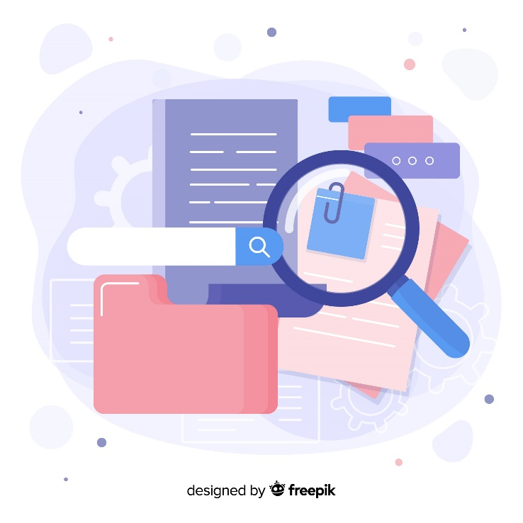
Are there Links to Other Resources
If you are unsure about the reliability of the legal information you have found, search again to see if you can find the same information somewhere else. Finding the same information in multiple places can be a good indication that it is accurate. In addition, if a website indicates where the information has come from, you can check the sources yourself to ensure accuracy.

Slide 53
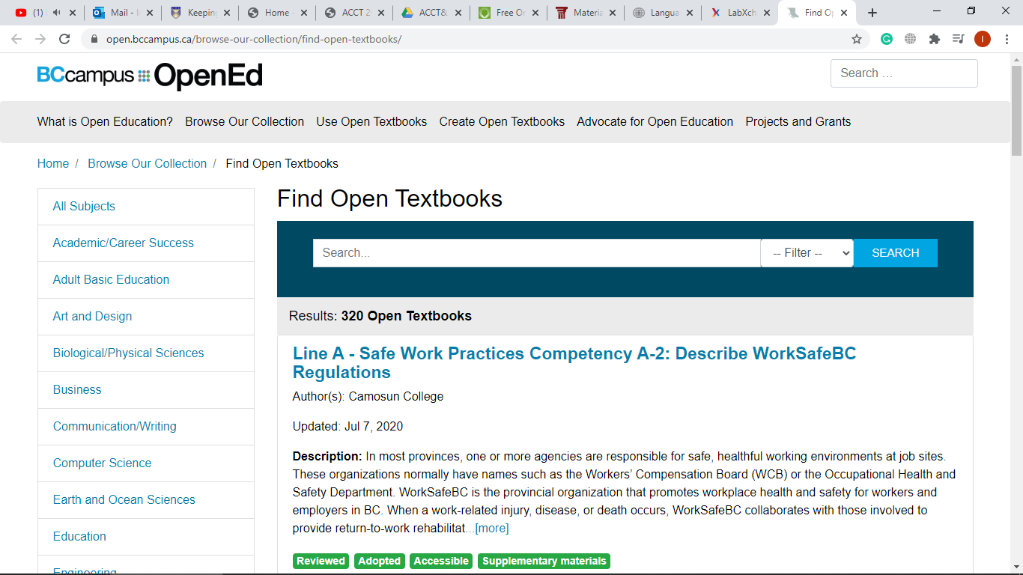
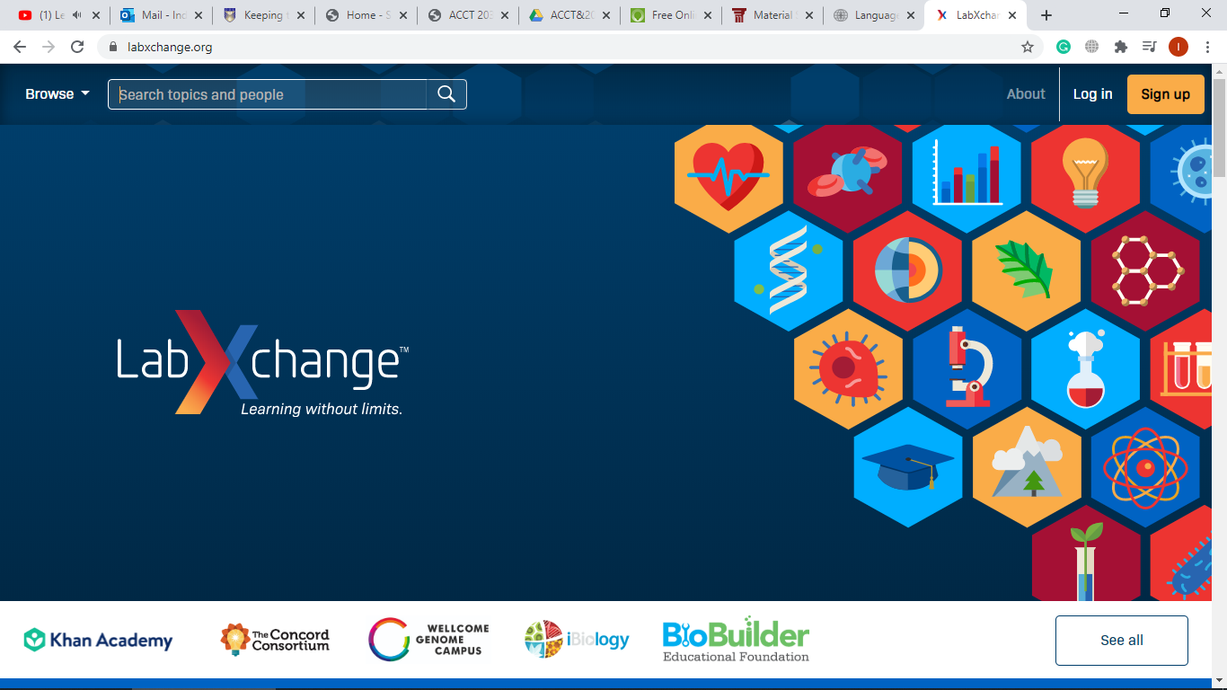
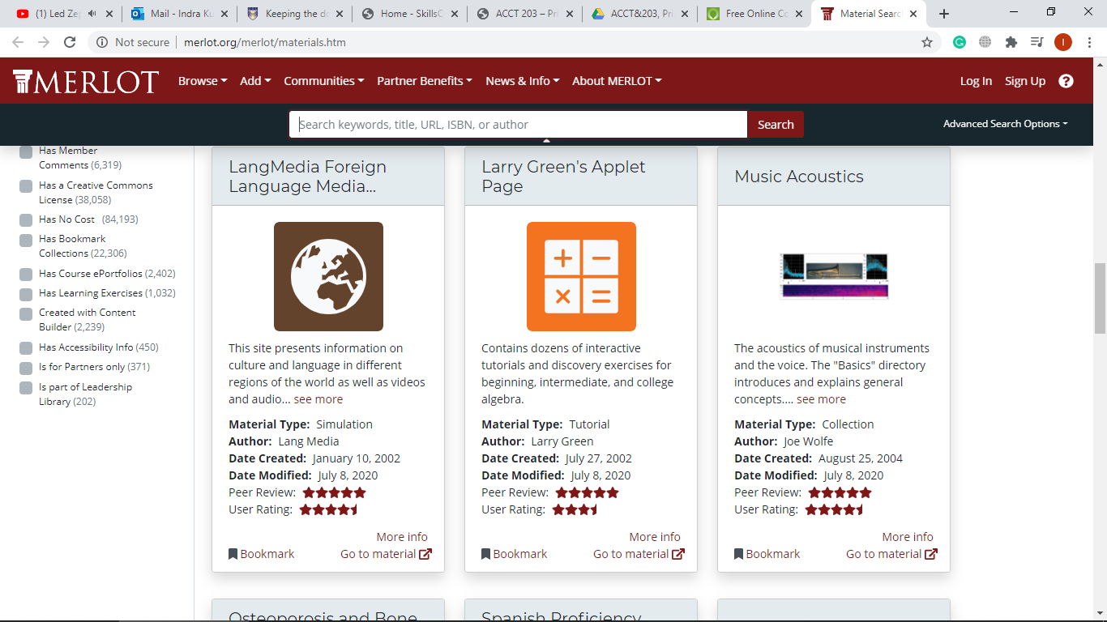
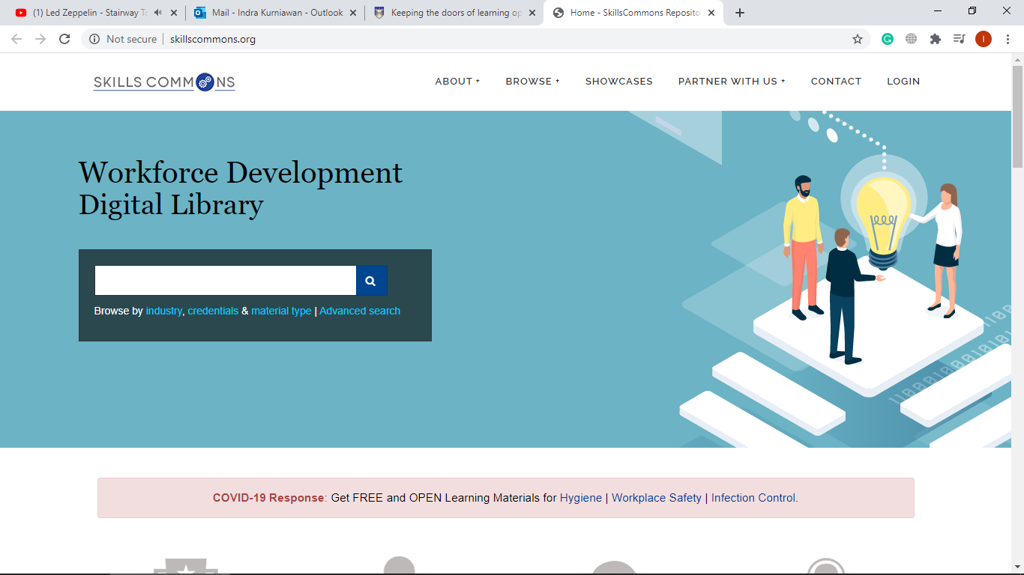
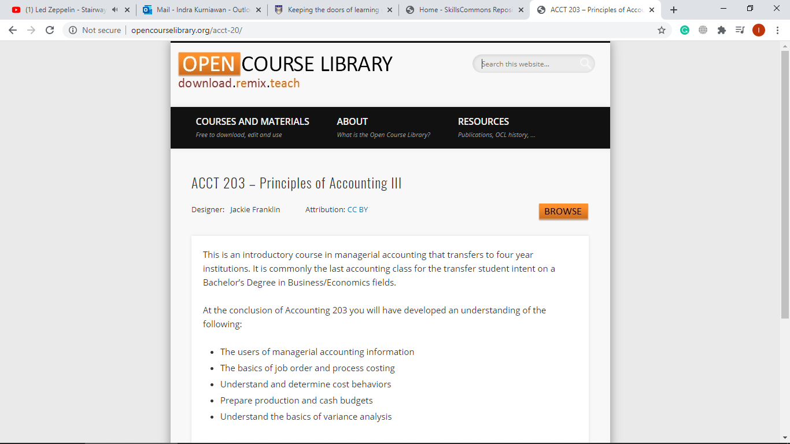
Some Credible and Useful Online Resources

Slide 54
BC Open Textbooks
over 300 textbooks on different subjects available in different formats.
https://open.bccampus.ca/browse-our-collection/find-open-textbooks/
Notes:
BC Open Textbooks:

Slide 55
LabXchange
an online community for learning, sharing, and collaboration.
https://www.labxchange.org/
Notes:
LabXchange: an online community for learning, sharing, and collaboration.

Slide 56
MERLOT
a high-quality sharable online learning resources repository contributed by member institutions from around the world.
https://www.merlot.org/merlot/materials.htm
Notes:
MERLOT: a high-quality sharable online learning resources repository contributed by member institutions from around the world.

Slide 57
Open Course Library
a collection of sharable course materials at college level.
http://opencourselibrary.org/acct-20/
Notes:
Open Course Library: a collection of sharable course materials at college level.

Slide 58
Skills Commons
supported by the US Department of Labor’s Trade Adjustment Assistance Community College and Career Training (TAACCCT), this platform provides learning resources for job-driven workforce development.
http://www.skillscommons.org/
Notes:
Skills Commons:

Slide 59
Wrap up
“
The future belongs to the brave and curious. So if you’re serious about learning something new, follow these steps and you’ll be on the path to achieving your dreams by making your goals a top priority in your life.
Speak up, connect, be passionate, be open minded, and regulate your self-control. You’ll be surprised on how motivated you are to keep improving yourself as a human.

Slide 60

Good luck,
and thank you – for hearing me out

